Slide 1
Course Title: Programming Language I
Course Code: CSE110
Semester: Fall 2022

Slide 2
Slack Workspace Link:
Please join slack workspace for CSE110 course by the following link:
https://join.slack.com/t/cse110-fall-2022/signup

Slide 3
buX
https://bux.bracu.ac.bd/courses/course-v1:buX+CSE110+2022_Fall/course/

Slide 4
Faculty Information
Name: Khondoker Nazia Iqbal
Faculty Initial: KNI
Email: ext.nazia.iqbal@bracu.ac.bd
Room Number: UB80601

Slide 5
Marks Distribution
Attendance & Class performance - 5
Quiz - 20 Best (n-1) quizzes will be counted
Midterm - 20 (4th November)
Lab - 25 (All the labs will be counted)
Final - 30 (24th December)

Slide 6

Introduction to Python
What is Python?
High level (Human readable Language)
No compiler is needed
Compiler converts source code to machine language
In 1991 python is officially released

Slide 7
Why Python is useful?
Easy to learn and use
English like commands
No need to write everything from scratch.
Lengthy problems solved in few lines with the help of libraries

Slide 8
Introduction to Variable and Data type

Slide 9
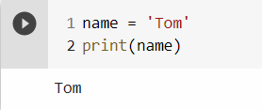
Variables
A variable is a reserved memory location to store values
Variable Declarations
Lets see an example of variable declaration
Syntax: variable_name = value
>>> name = ‘Tom’
>>> print(name)
Output: Tom

Slide 10
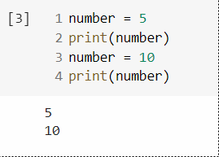
Variable Declarations
You can re-declare the variable even after you have declared it once
Example:
>>> number = 5
>>> number = 10
>>> print(number)
Output: 10

Slide 11
Variable Naming Conventions
While naming the variables, we need to follow some rules which are called ‘Variable naming conventions’
Variable names can have letters (A-Z),(a-z), digits (0-9) and underscores ‘_’
Variable names can not start with digits
Case sensitive
Use ‘_’ between words in a variable
Variable names can not have whitespaces and special characters (+,-,!,@,$,#,%).

Slide 12
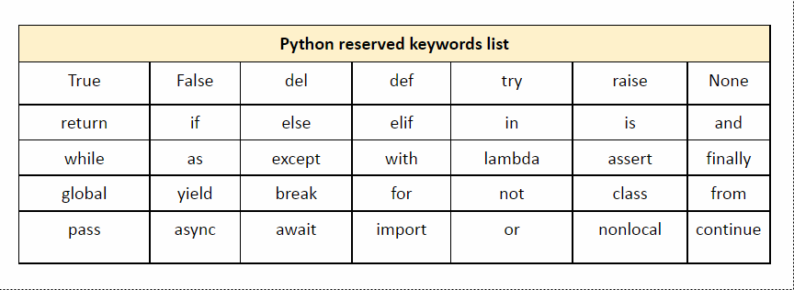
Variable Naming Conventions
Variable names cannot be a reserved keyword for python

Slide 13
Data Types
We use variables to store values and every value in python has a data type.
Numeric
Integer x = 4
Float x = 4.76
Complex Number x = 5+3i
Sequence Type: Ordered collection of similar or different data types
String x = ‘Hello world’
List x = [‘red’, ‘blue’, ‘green’]
Tuple x = (‘red’, ‘blue’, ‘green’)

Slide 14
Data Types
Boolean:
Data with one of the two built-in values: True or False
Dictionary:
Unordered collection of data in key:value pair form.
cardict = {
“brand”: “Lamborghini”, “model”: “Aventador”, “year”: 2019
}

Slide 15
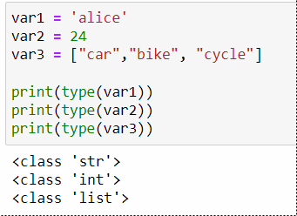
type() function
To know the type of a variable, we use type() function
Syntax: type(variable_name)

Slide 16
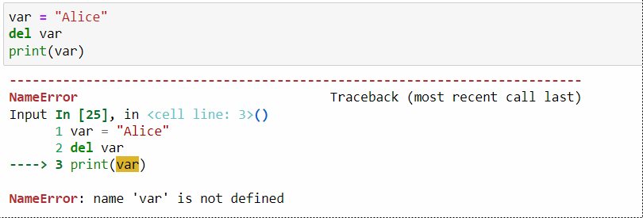
Deleting a Variable
We can use del command to delete a variable
Example:

Slide 17
input() function
To take input from the user, we use input() function
input(‘promt’) It will read line from keyboard
input() pauses program execution to allow the user to type a line of input from keyboard. Once the user presses ‘Enter’ key, all typed characters are read and returned as a string
>>> s = input(“Enter your name:”)
Enter your name: Alice
>>>print(s)
Output: Alice
>>> s = input()
I love python
>>>print(s)
Output: I love python

Slide 18
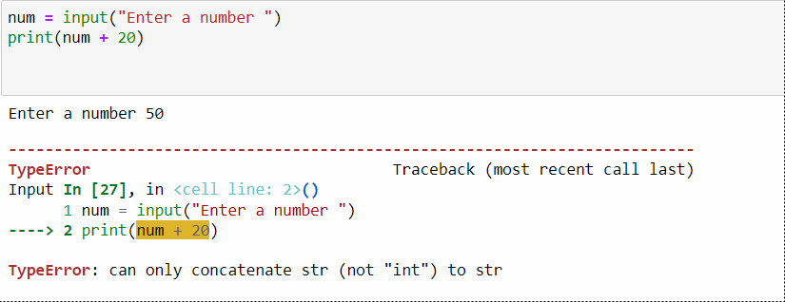
Limitation of input() function
input() function always returns a string. If you want a numeric type, then you need to convert the string to the appropriate type with int(), float() or str() which are built in functions.

